Slide 1
Sentiment Analysis
CAPSTONE PROJECT
Presented By:
Student Name- Nagisetti Chaitanya Rajeswari
College Name- Daita Madhusudana Sastry Sri Venkateswara Hindu College of Engineering
(DMSSVHCE)
Department- Computer Science and Engineering

Slide 2
OUTLINE
Problem Statement
Proposed System/Solution
System Development Approach
Algorithm & Deployment
Result
Conclusion
Future Scope
References

Slide 3
Problem Statement
With the rapid growth of online platforms for sharing opinions and reviews, restaurants often rely on the customer feedback to improve their services and attract a new customers. Analyzing the sentiment of these reviews can provide valuable insights into customer satisfaction.

Slide 4
Proposed Solution
The proposed system aims to address the customer reviews to improve restaurants services and attract a new customers. This involves develop a sentiment analysis model to classify restaurant reviews as positive or negative. Analysing the sentiment of these reviews can provide valuable insights into customer satisfaction. The solution will consist of the following components:
Data Collection:
Gather customer review data on restaurants, including positive and negative reviews.
Store the collected data into a CVS or other file.
Data Preprocessing:
Clean and preprocess the collected data to handle missing values, outliers, and inconsistencies.
Feature engineering to extract relevant features from the data that might impact restaurants services.
Machine Learning Algorithm:
Implement a machine learning algorithm, to train and test our data using TfidVectorizer functiom MultinomialNB function etc.
Consider incorporating other factors like statistical information, sentiment value counts, word count of reviews, frequency of specific words to improve accurate analysis.
Deployment:
Preprocess the text of the customer reviews like converting the data set into lower case, tokenization, removing the stop words, stemming etc.
Process a word into its base or dictionary form, removing the numbers from reviews, removing special characters like @,#,%, etc.
Evaluation:
Assess the model's performance using appropriate metrics such as F1 Precision etc.
Fine-tune the model based on feedback and continuous monitoring of prediction accuracy.

Slide 5
System Approach
System requirements :
Windows 10 operating system.
Apps supporting Python like “Jupyter notebook”.
Library required to build the model :
Pandas
Matplot library
Seaborn
Wordcloud
Collections
String
NLTK
Wordnet
Stopword
lemmatizer
Re
Contractions
Emoji
Beautifulsoup4, etc.

Slide 6
Algorithm & Deployment
Algorithm Selection:
Navie bayes algorithm is used for Machine learning, for accurate score and classification report.
Data Input:
Here the input data is Review and liked data set. We classifiy the review data set and liked data set here.
Training Process:
We will import the necessary models for text analysis and sentiment analysis.
We create two vectores that are x, y indicating review and liked data set respectively. We train the both data set and then test them using x_train, y_train to train and x_test, y_test for testing the data set
We use MultinomialNB() function for training the data.
Prediction Process:
we predict the trained data set accuracy and create a report.
We create accuracy prediction and classification report.
The accuracy I obtained in this model is 0.8 and the precision in classification report is 0.76.
Classification report has precision, recall, f1-socre and support.

Slide 7
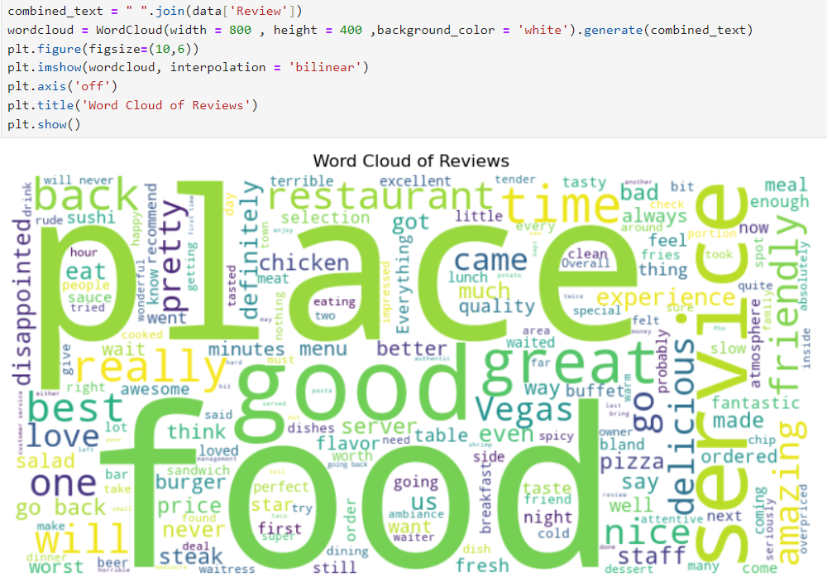
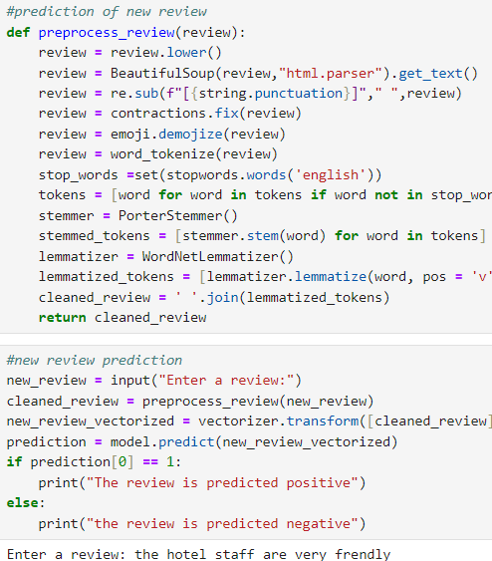
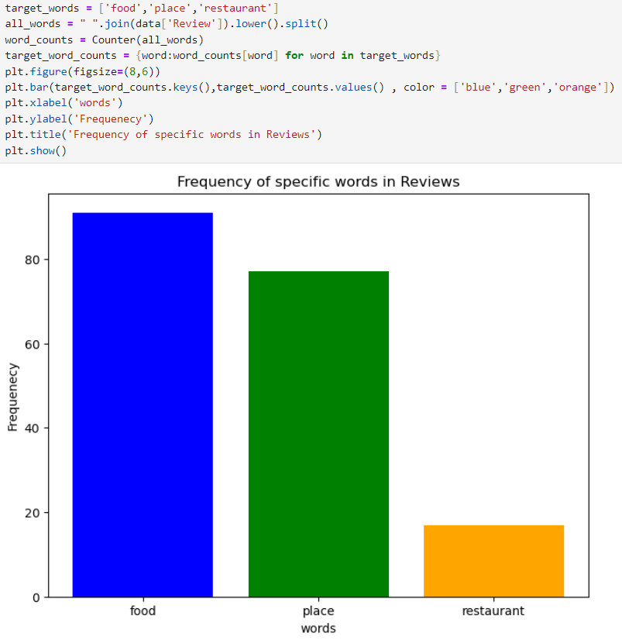
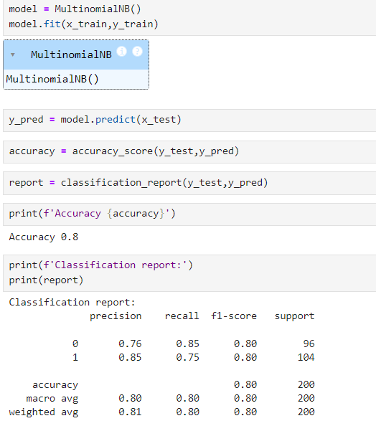
Result

Slide 8
Conclusion
Finally, the sentimental analysis model is used to understand the emotional tone of the text.
It identified the positive and negative sentiments in a piece of writing.
This is a basic model which is very effective for sentiment analysis.
There can be some improvements like we can find the neutral sentiments like the neutral emotional tone which is neither dislike or like.
The sentiment analysis model is important for accurate sentiment review count predictions for analysing the restaurant services. Big companies like google etc use this type of model for suggesting good restaurants according to their preferences.

Slide 9
Future scope
Sentiment analysis is a uniquely powerful tool for business that are looking to measure attitudes, feeling and emotions regarding their brand. To date, the majority of the sentiment analysis projects have been conducted almost exclusively by companies and brand through the use of social media data, survey responses and other hubs of user generated content
The future of sentiment analysis is going to continue to dig deeper, far past the surface of the number of likes, comments and shares and aim to reach and truly understand the significance of social media interactions and what they tell us about the consumers behind the screens.
As a result of deeper and better understanding of the feelings, emotions and sentiments of a brand or organization’s key, high-value audiences, members of these audiences will increasingly receive experiences and messages that are personalized and directly related to their wants and needs. Rather than segment markets based on age, gender, income and other surface demographics, organizations can further segment based on how their audience members actually feel about the brand or how they use social media.

Slide 10
References
The future scope of sentiment analysis :https://www.linkedin.com/pulse/future-sentiment-analysis-shahbaz-anwar
Source code reference : https://edunetfoundationorg-my.sharepoint.com/:f:/g/personal/anusha_edunetfoundation_org/Ei-00pRRvYVCjL2Ly4wFUCABnx3QEII7flCSGKANfKLAgg

Slide 11
THANK YOU

